Slide 1
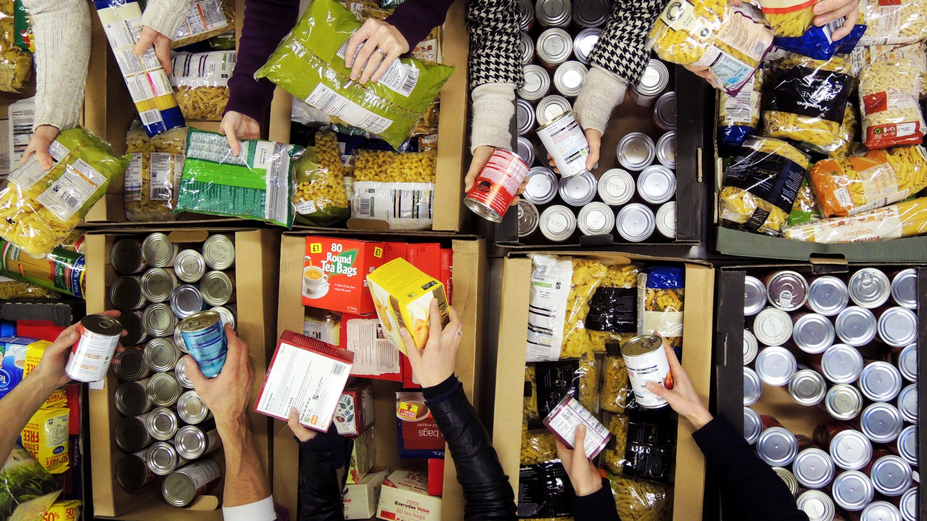

Slide 2
“I have come that they may have life, and have it to the full”.
John 10:10
We are the Trussell Trust and we exist so we can all be free from hunger.
Together, we’re more than 1,300 local food bank centres, of which 800 are based in churches, across the UK, providing practical support for people facing hardship.
But emergency food isn’t a long-term solution to hunger. People need food banks when they don’t have enough money for essentials. That’s why we also work with communities and churches across the UK to change the things that push people to need a food bank.
Notes:
Additional information:
Trussell Trust support food banks to provide three days’ nutritionally-balanced emergency food to people in crisis, as well as support to help people resolve the challenges they’re facing, and ensure they do not need to use a food bank again.
People are referred to Trussell Trust food banks by external agencies and professionals - like health visitors, social workers, or Citizens Advice staff - if they are in crisis.
When they are referred, they are issued with a food bank voucher. When they bring this to their local food bank, they can receive a food bank parcel and compassionate, practical support.
Over the last five years, food bank use in our network has increased by 73%. Year upon year, more and more people are struggling to eat because they simply cannot afford food.
The main reasons that people need to use a food bank are because of problems with benefits, high living costs (especially housing) and in work poverty (low incomes).

Slide 3
We’re made in the image of God. The bible tells us that Jesus says, “I have come that they may have life, and have it to the full.” Being trapped by poverty is at odds with God’s plan for fullness.
There is a dignity in being able to afford the essentials and provide for yourself and others/family. There’s power in coming together, we’re louder when we unite our voices and call for change.
Together, we are thousands and thousands of people, from communities across the UK, working together towards a more just future where none of us need a food bank.
Notes:
Additional information:
Trussell Trust support food banks to provide three days’ nutritionally-balanced emergency food to people in crisis, as well as support to help people resolve the challenges they’re facing, and ensure they do not need to use a food bank again.
People are referred to Trussell Trust food banks by external agencies and professionals - like health visitors, social workers, or Citizens Advice staff - if they are in crisis.
When they are referred, they are issued with a food bank voucher. When they bring this to their local food bank, they can receive a food bank parcel and compassionate, practical support.
Over the last five years, food bank use in our network has increased by 73%. Year upon year, more and more people are struggling to eat because they simply cannot afford food.
The main reasons that people need to use a food bank are because of problems with benefits, high living costs (especially housing) and in work poverty (low incomes).

Slide 4
Harvest Conversation Starters
Use the following slides to spark conversations with your group or church to build understanding and empathy for people who need food banks, and the changes needed to ensure no one needs to use them in the future.

Slide 5
Aneita’s Story
Aneita experienced poverty as a child and into her adult life but was able to change her situation by working for the NHS. After moving from full-time to part-time work to care for her daughter, Aneita’s tax credits were stopped and she was told her benefits had been overpaid by £5,000. She was left with no option but to borrow money and turn to a food bank just to get by.
“Poverty does not discriminate; it can and will single you out through no fault of your own, whether through relationship breakdowns, death, loss of employment, change of employment or mental health. But people shouldn’t need food banks. We need a real living wage or benefit that reflects today’s cost of living. This would give people the decency to be able to go to the supermarket and buy their food, not have it handed to them.”
+ How would it make you feel having to ask friends or family to lend you money to buy food?

Slide 6
Louise’s Story
Louise has anxiety, depression, and complex-PTSD. Her mental health issues mean she sometimes has periods when she isn’t able to work and, when issues with her social security payments left her without enough money, she had no option but to use a food bank.
“The first thing they did at the food bank was give me a cup of tea. They treated me like a human, not just an issue to be solved. When you are battling against bureaucracy, you feel like just a number. Someone giving me a cup of tea, asking if I would prefer tea or coffee in my food bank package, made me feel human again."
+ Louise speaks about how a cup of tea made her feel human again, how it gave her some dignity. Think about a time when either you have felt your dignity has been stripped away by someone, or you have witnessed it happen to someone else?
+Who in your community may need to be shown compassion through hospitality? – consider the bible verse 1 Peter 4:9 - Be hospitable to one another without complaint.
+ Tea can be transformational - tell us about a time when sitting down and having a cup of tea with someone changed something for you.

Slide 7
Caroline’s Story
Caroline first needed social security when she was working as a self-employed registered childminder. She found employment in January 2020 but, when the pandemic hit, she was put on furlough and lost 80% of her wages. In August 2020, she was made redundant when the nursery she was working for closed for good.
“Imagine telling your child they can’t go to a birthday party, imagine not having £1 in your purse when your child’s tooth falls out, imagine sitting watching your child eat whilst your own stomach grumbles with hunger as you try to stretch your food bank parcel. Imagine having no choice over the food in your cupboard as it’s donated to you. It’s not easy walking into a food bank and saying you need help.”
+ How did you decide what you were going to eat today? Imagine if those choices were taken away from you or if you had to eat the same thing day in and day out

Slide 8
Lisa’s Story
When Lisa lost her mother to cancer and her 11-year relationship with the father of her children ended in the same year, she experienced severe anxiety, stress and depression and wasn’t well enough to work. Although she started receiving social security payments, they weren’t enough to cover essential costs for herself and her children, so she had no option but to use a food bank.
“I just had to put my children first. I had to prioritise things like fuel to be able to take the children to school over other expenditure. Especially with the increased cost of living, you need more to be able to live a normal life. I spoke to my GP and they referred me to the local food bank. We used the food bank 3 or 4 times that year and if that support hadn’t been in place, we wouldn’t have been able to get through the hardship we faced.”
+ If you had to make the decision to heat your home, buy food, or pay for fuel, which one would you choose and why?

Slide 9
John’s Story
When John left care, he had no support and became homeless. Unable to afford essentials such as food and shelter, he had no option but to use a food bank. Since then, he has started volunteering for his local food bank and has become a Trustee.
“When I was homeless, food banks saved me. They provided me with food, shower gels and other necessities I couldn’t afford. But it also gave me somewhere to go for a chat or to see someone. The kindness I was shown there has stuck with me.”
+ Are we always as welcoming as we could be? John talks about the kindness he was shown entering the food bank for the first time – are we providing the same welcome in our home life, churches and community?
+ What does a good welcome look like? Consider the Romans 15:7: Accept one another, then, just as Christ accepted you, in order to bring praise to God

Slide 10
Children in the UK are facing hunger.
The food banks in our network provided 2.1 million emergency food parcels to people struggling to afford the essentials between April 2021 and March 2022.
832,000 of these went to children.
+ How does this make you feel? What do you think you can do within your community and church to support children and families who may be struggling ?

Slide 11
Providing more than emergency food.
People need food banks when they don’t have enough money for essentials. That’s why we work with communities across the UK to change the things that push people to need a food bank in the first place.
What other practical support do food banks in our network provide to reduce the need for emergency food in their communities?
a) Help navigating the social security system
b) Compassionate financial advice and support
c) Signposting to other essential services to address the underlying cause of people’s hardship
+ It is actually all of the above! Does this surprise you and why do you think this is important?

Slide 12
The cost of living crisis is having an impact on all of us.
As food and energy prices soar, families across the UK are feeling the biggest squeeze on incomes in a generation.
+ How are you being impacted by the cost of living crisis? How do you think it may also affect people within your community and church?

Slide 13
Working towards a more just future.
At the Trussell Trust, we work with communities across the UK to change the things that push people to need a food bank. It is really important to us that churches consider justice alongside compassion so that we can end the need for food banks in the UK?
+ What do you think needs to change so that all of us have enough money for the essentials, and no one needs to use a food bank in the future?
+ In what ways do you think your church can help influence decision makers to make systematic changes to help those facing poverty?
+ Can you think of any Bible verse that call on us as Christians to seek Justice?

Slide 14
Join the fight against hunger.
With rising living costs, energy prices at a record high and Universal Credit barely covering the essentials, more and more people are being left with no option but to use a food bank.
This has to stop.
+ Have you heard anything today that you didn’t know? Or that has inspired you to act and ensure that everyone can afford the essentials? How might your church be able to join together to create change?

Slide 15
Thank you for supporting us
For more info visit: trusselltrust.org/ church-support

